Slide 1
Introduction to Statistical\Machine Learning
The Case of Linear Regression

Slide 2
Motivating Example
You work for a company whose goal is to increase sales.
Study the relationship between advertising expenditure and sales. If there is an association, the “policy” to increase sales could be to increase advertising expenditure.
Objective:
Develop a model that can be used to predict sales based on media budgets.

Slide 3
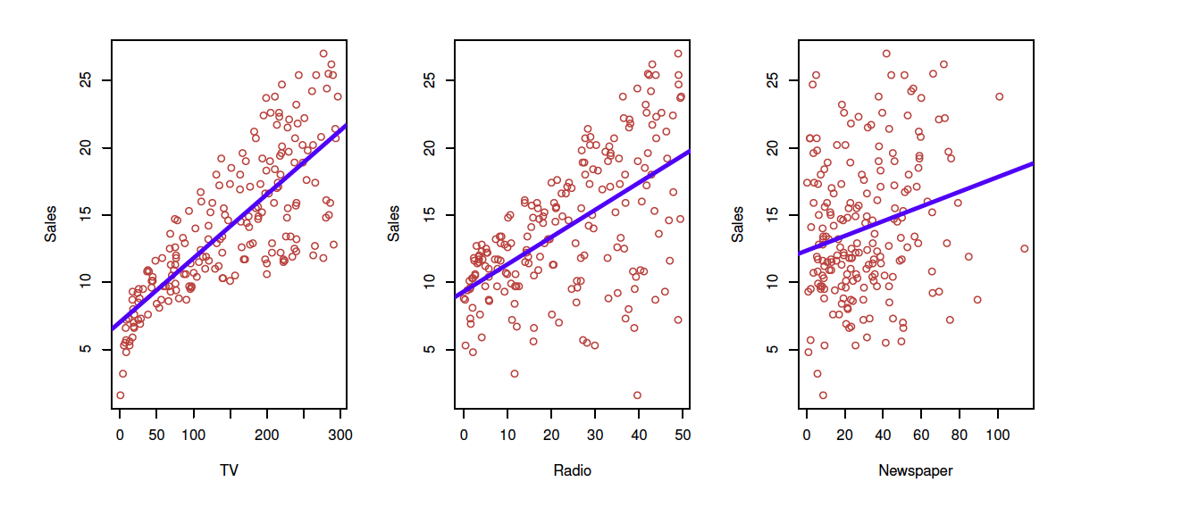
Sales = Output (aka response, dependent) variable (Y)
Input Variables (aka predictors, independent variables, features)
X1: TV
X2: Radio
X3: Newspaper

Slide 4
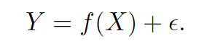
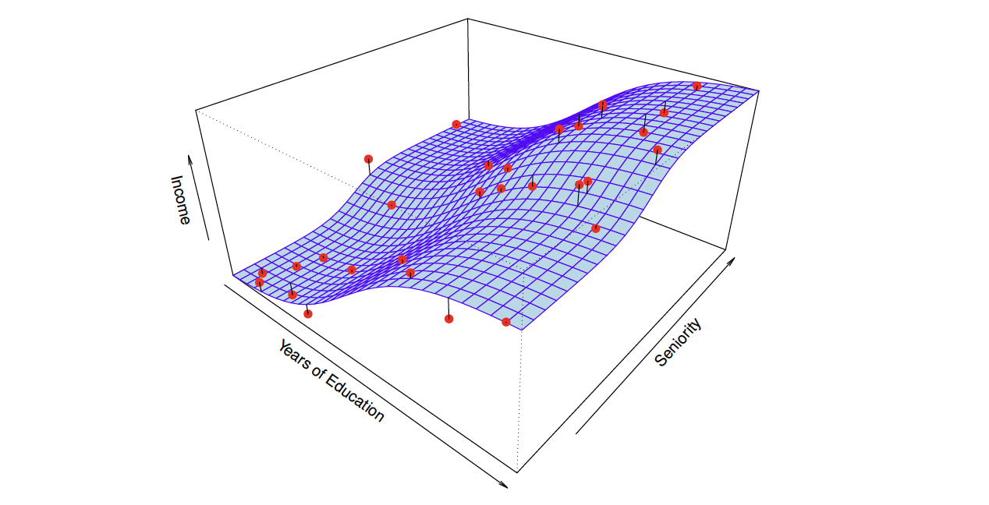
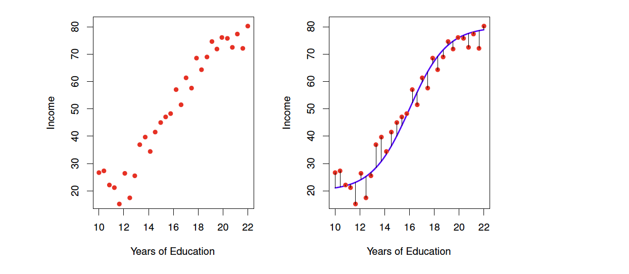
General Objective
Given some quantitative response Y and p different predictors (X1, X2, X3,…Xp), we assume there is some relationship between Y and X = (X1, X2, X3,…Xp) written as:

Slide 5
What is Statistical Learning?
A set of approaches for estimating f
Why?

Slide 6
To Predict or To Explain (Inference)

Slide 7
Explanatory Modeling
Common in Social Sciences.
Strong Theoretical Justification.
Explain some outcome (Y) as a function of various factors (X).
Often association-based models.
Occasionally a causal model used (longitudinal data. Difference-in-Differences)
Which predictors are associated with the response?
What is the relationship between the independent variables and outcome variables (positive? negative?)

Slide 8
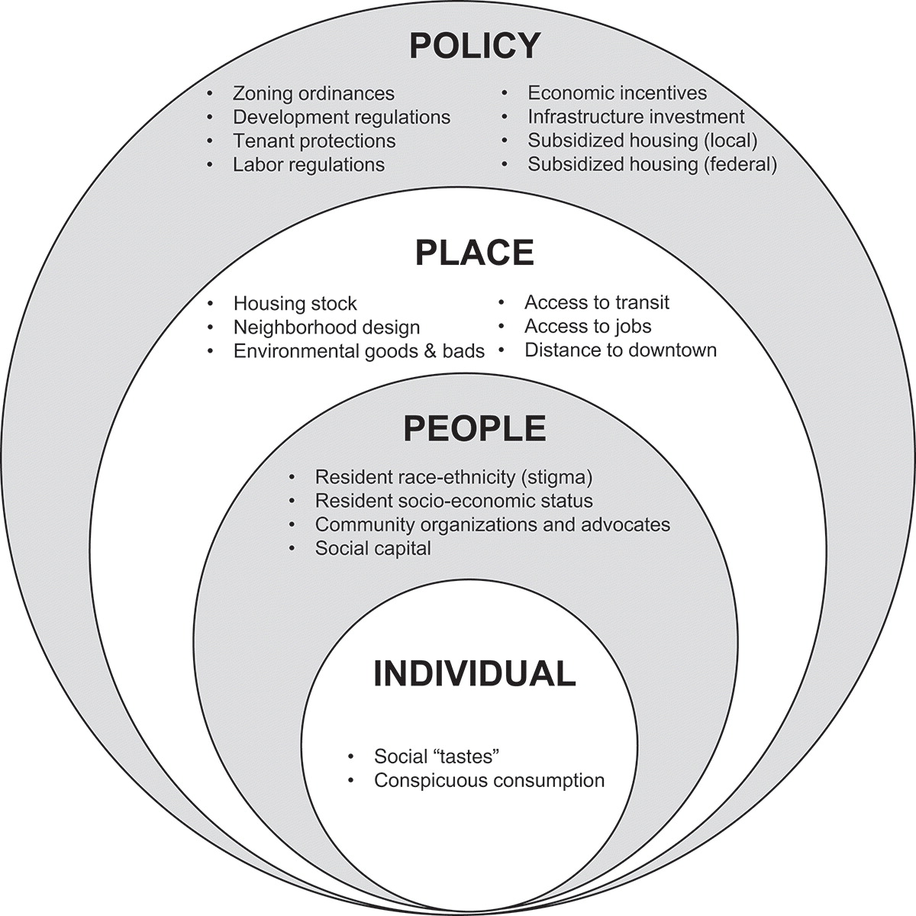
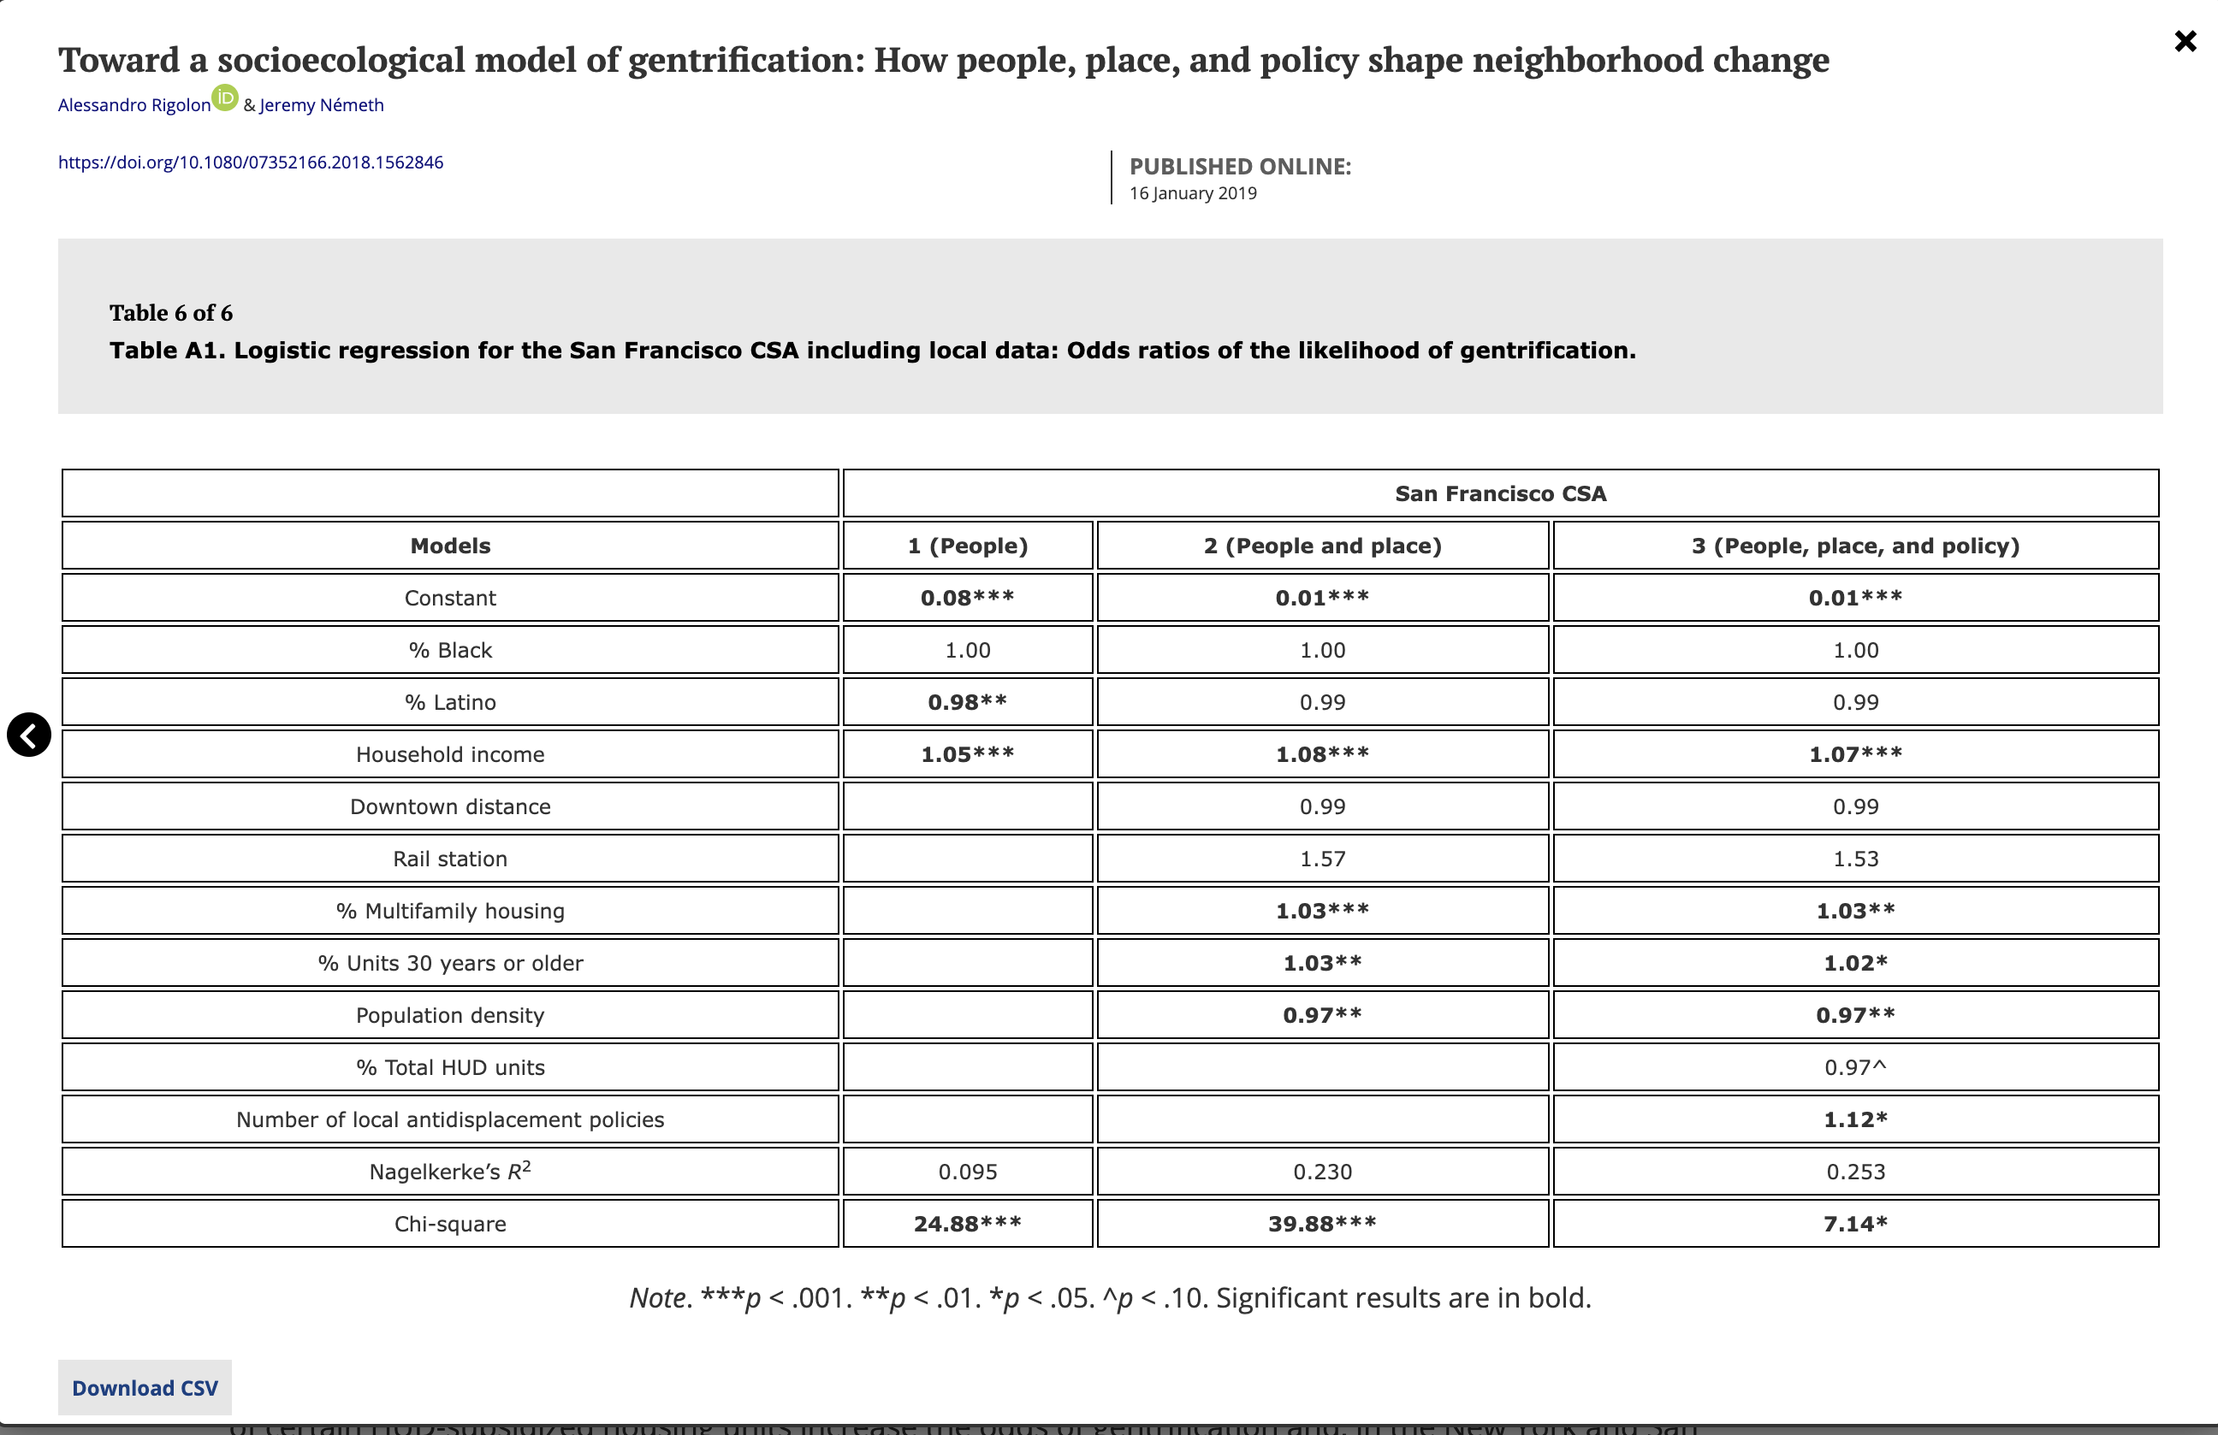
Example: Explaining Gentrification
Theoretical Model
https://www.tandfonline.com/doi/full/10.1080/07352166.2018.1562846?casa_token=Qx59SQTfHHkAAAAA%3AbD5ysPOr1DBI615dSOIH8qoRvBlZrjSKlGIowU_PBwnKVejI8JvtgyQTkqQW1CjYbiwm1Ltpa8y8-w

Slide 9
Predictive Modeling
Apply a statistical or data mining algorithm to data to predict new or future observations.
Predict (Y) output/outcome values for new observations, given their input values (X).
Generate predicted values of a dependent variable by applying an estimated model to a set of explanatory variables.
Doesn’t have to be about forecasting (the future)
Predict on a portion of the data not used for model estimation.

Slide 10
Steps for Making Predictions
Define an estimation set to fit the model and an evaluation set to generate predictions for. (testing & training datasets)
Estimate the model using the estimations set.
Make predictions of the outcome using the model and the data in the evaluation set.
Evaluate the performance of the predictions against the observed outcomes.

Slide 11
How to Choose Evaluation Set & Evaluate Predictive Performance?
In-Sample Evaluation
Use the same data for estimation to make predictions.
R-Squared is an example of aggregate fit using this evaluation method.
Subject to Overfitting

Slide 12
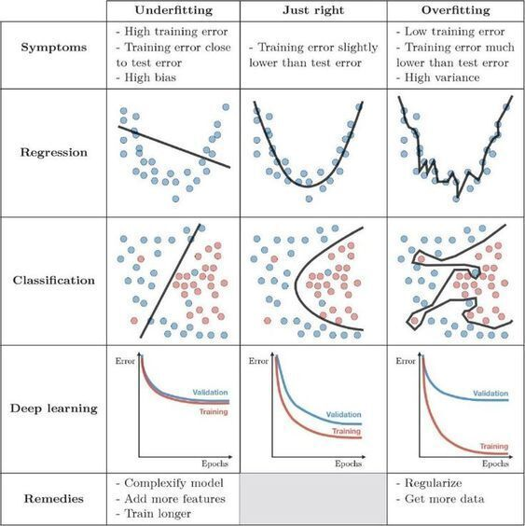
What’s Overfitting??

Slide 13
Cross-Validation
Split data into evaluation\estimation set (Testing & Training)
Typical approach used in machine learning
Risk of overfitting the data explicitly addressed.
Predictions never made using all the data that went into the model.

Slide 14
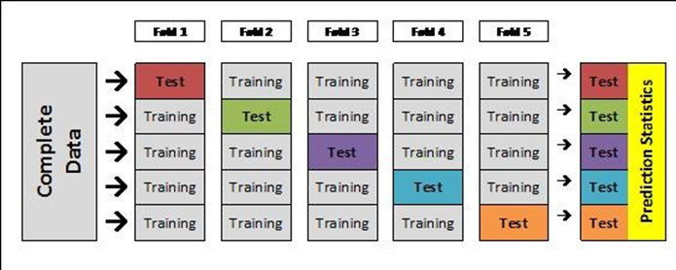
K-Fold Cross-Validation
Most Common Method.
Divides data into k equal sized ‘folds’ (k often = 5 or 10)
Model is then estimated k times. Each time omitting one of the folds from the estimation process.
The omitted fold is used as the evaluation set.

Slide 15
Leave-One-Out CV
Special Case of k-Fold where k = N

Slide 16
External Evaluation
Use data that are completely “unseen”
A different geographic area

Slide 17
Linear Regression
The Old Standard

Slide 18
Questions Linear Regression Can Answer
Is there a relationship between advertising budget and sales?
How strong is the relationship between advertising budget and sales?
Which media are associated with sales?
How large is the association between each medium and sales?
For every dollar spent on advertising in a particular medium, by what amount will sales increase?
How accurately can we predict future sales?
Is the relationship linear?

Slide 19
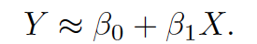
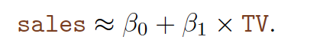
Simple Linear Regression
Assumes a linear relationship between X and Y (one predictor, one outcome variable)
Slope
Sales
Intercept
Slope
Intercept
TV

Slide 20
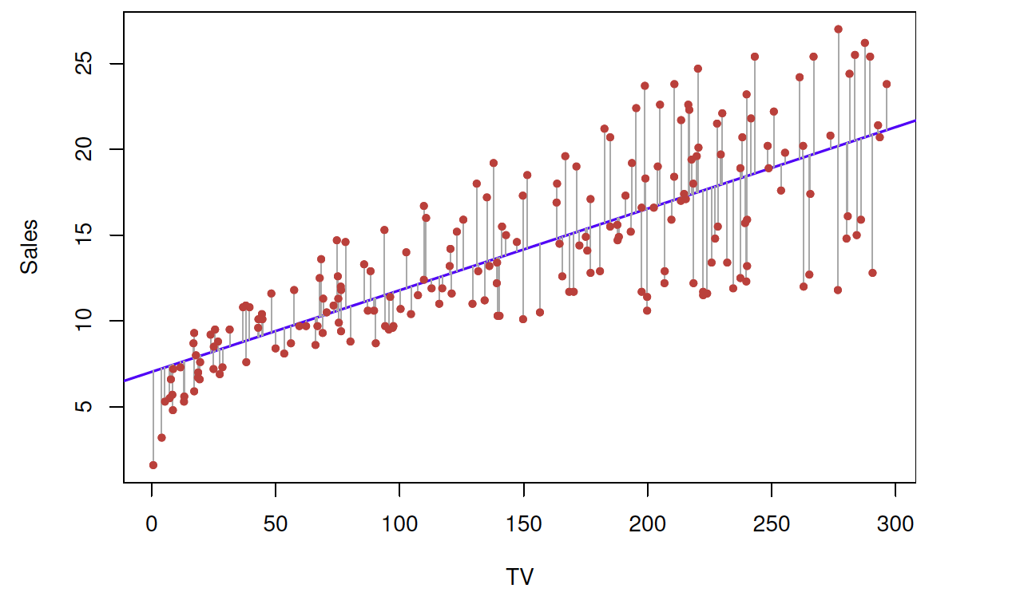
Estimating Coefficients
are unknown
Find the line that best fits the data sample of advertising dollars and sales dollars.
We are going to use a method called
least squares for figuring out that line.
Minimizes the residual sum of squares
Intercept = 7.03 (Expected sales (Y) when x = 0)
Slope = 0.00475 (Every additional $1000 spent on TV advertising, associated with selling approx. 47.5 units of the product)

Slide 21
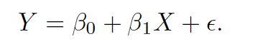
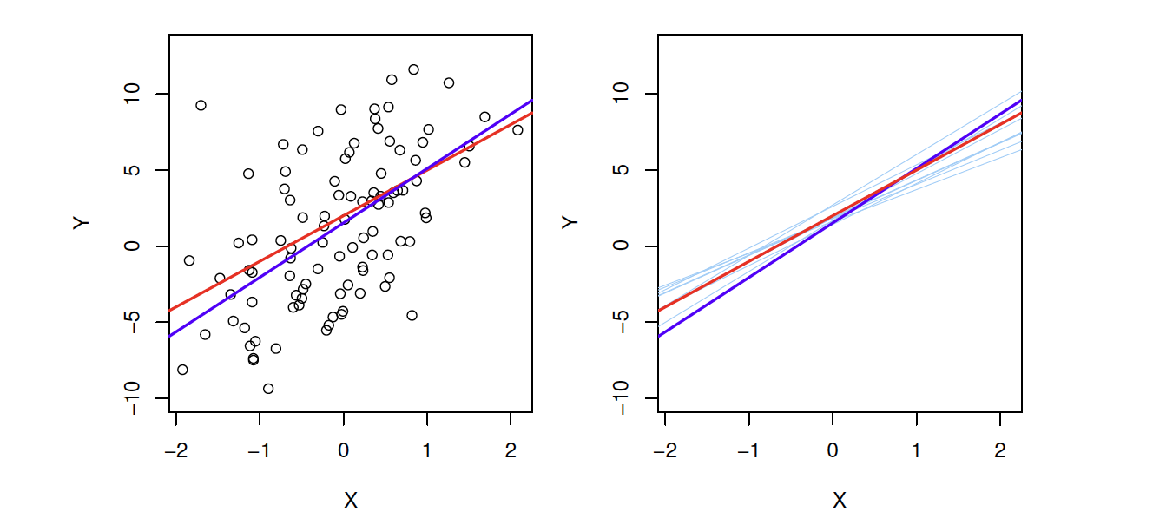
How Good is This Line at Capturing the TRUE (Unknown) Relationship?
Red = ‘Population’ Regression Line (The Holy Grail).
Blue = Estimated Line Based on Observed Sample Data

Slide 22
Why Do I Care?
Our estimated coefficients are just that. Estimates of the TRUE UNKNOWN (Holy Grail) values of that line (if we had all the advertising and sales values in the world. Which we don’t, we just have a sample).
All estimates come with errors.
Standard Error – amount by which the estimate differs from actual value.
Standard Errors can be used to compute Confidence Intervals
95% of the time, the Confidence Interval range will include the actual, unknown value of the parameter (the Holy Grail).

Slide 23
We Can Use The Values to Perform Hypothesis Tests
Null Hypothesis (H0):
There is no relationship between X and Y
Alternative Hypothesis (Ha):
There is a relationship between X and Y
Null Hypothesis.
Slope = 0
We need to make sure our slope estimate is far, far, far from 0 so
that we can be very confident that the actual true (Holy Grail) estimate
is not 0.
Sales
TV

Slide 24
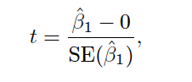
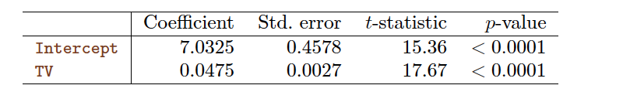
This is Where Standard Errors Become Handy
Small Standard Error → We don’t need a big slope value to be pretty sure the true Holy Grail slope isn’t 0.
Big Standard Errors → More uncertainty with our estimate.
The computer is going to give us a t-statistic!
number of standard deviations that the estimate is from 0.
The further away the better! (Bigger t = more confidence)

Slide 25
The P-Value
Probability that we would get a |t|-value as big as we did, in the case that
Small p-value:
unlikely to observe such a substantial association between the predictor and response variable due to chance, in the absence of any real association between the prediction and the response.
If p is small, we can infer there is an association between the predictor and the response.
We reject the null hypothesis and declare a relationship between X and Y if the p-value is small enough.
How small?
generally 0.05 or 0.01
= 0

Slide 26
The probability that the true (holy grail) value of this coefficient is actually 0, is <0.0001
Very slim.
Therefore, we can conclude that there is a [positive] relationship between TV ad spending
and sales.

Slide 27
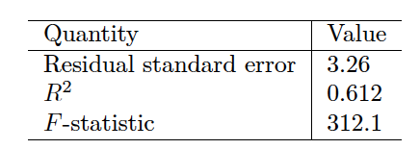
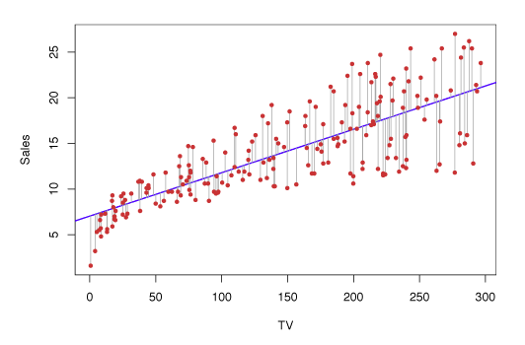
How Well Does the Model Fit the Data?
The case of In-Sample Evaluation.
RSE – Residual Standard Error
Average amount the response will deviate from the true regression line.
Average sales deviate from the true regression line by ~3,260 units, on average.
Predicting sales on basis of TV advertising alone will be off by that many units.
Measure of lack of fit.

Slide 28
R-Squared
Takes the form of proportion.
Always a value between 0-1
Proportion of variability in Y that can be explained using X
A measure of fit!

Slide 29
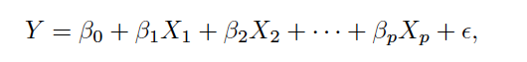
Multiple Linear Regression
With more than one predictor, give each one a separate slope coefficient in a single model.
B_{j} is then the average effect on Y of one unit increase in X_{j}, holding all other predictors fixed.

Slide 30
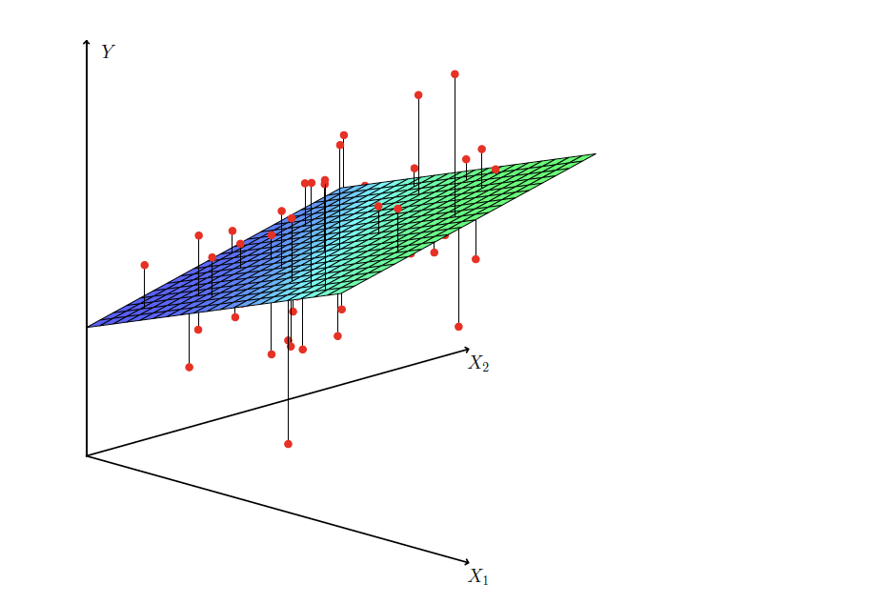
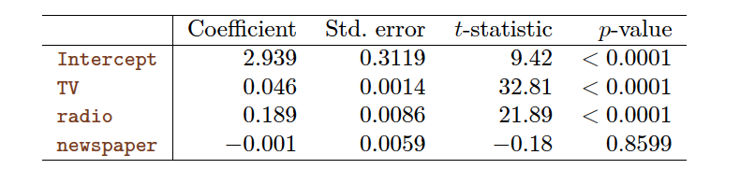
Interpretation
For a given amount of TV and Newspaper advertising, spending an additional $1000 on radio is associated with ~ 189 units of additional sales.

Slide 31
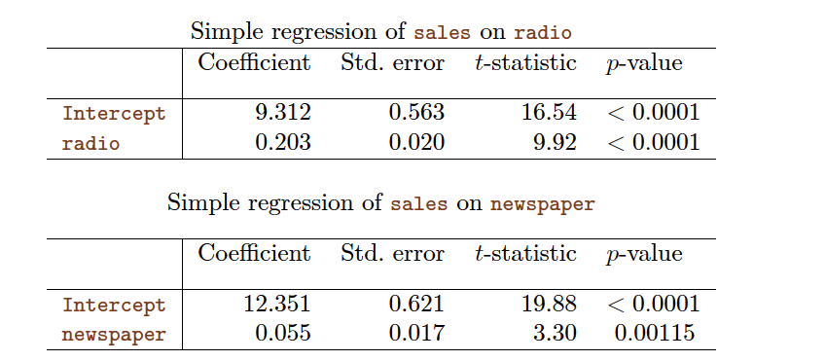
Different than Running Separate Simple Linear Regression
When controlling for radio spending, the newspaper coefficient becomes insignificant (no association)

Slide 32




Slide 33
Important Questions
Is at least one of the predictors useful in predicting the response?
Doe all the predictors help explain Y or is only a subset of the predictors useful?
How well does the model fit the data?
Given a set of predictor values, what response value should we predict, and how accurate is our prediction?

Slide 34
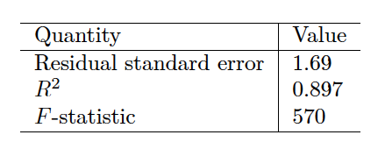
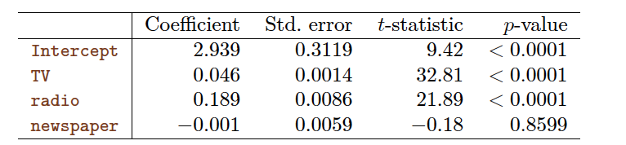
Is there are relationship between responses & predictors?
Compute F-Statistic (>1)
Examine associated p-values

Slide 35
Decide on Important Variables
Variable Selection
Manual
Forward/Backwards Selection (Machine-aided)

Slide 36
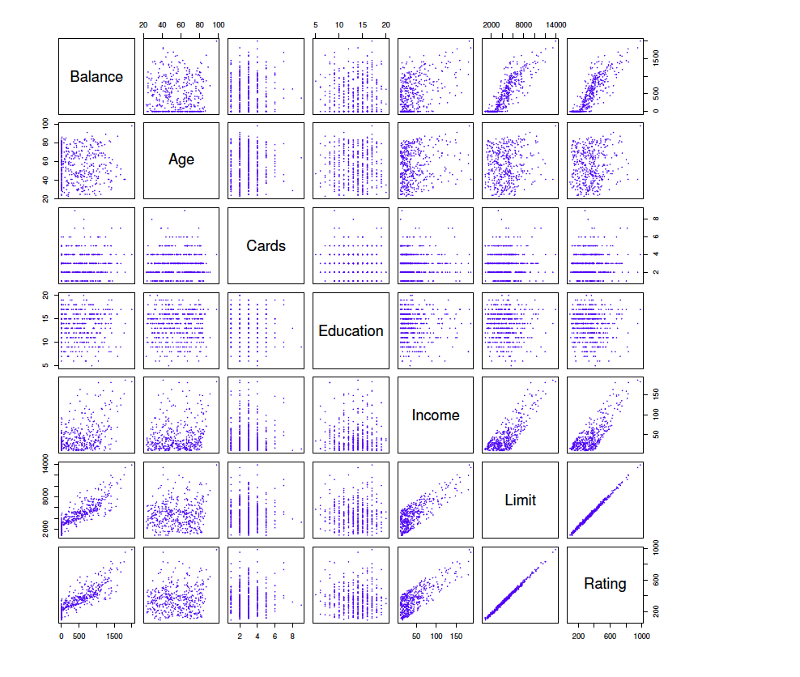
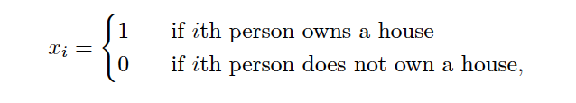
Qualitative Predictors (Factors)
If only 2-levels, create an indicator (dummy variable) that take on 2 possible numerical values

Slide 37
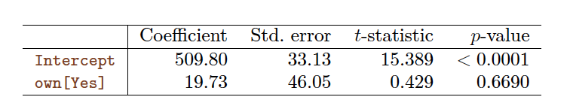
Interpreting Dummy Variable
Model of Credit Card Debt
Average credit card debt of non-owners (0) is $509.80
Average credit card debt of owners (1) is $19.73 More = $529.53

Slide 38
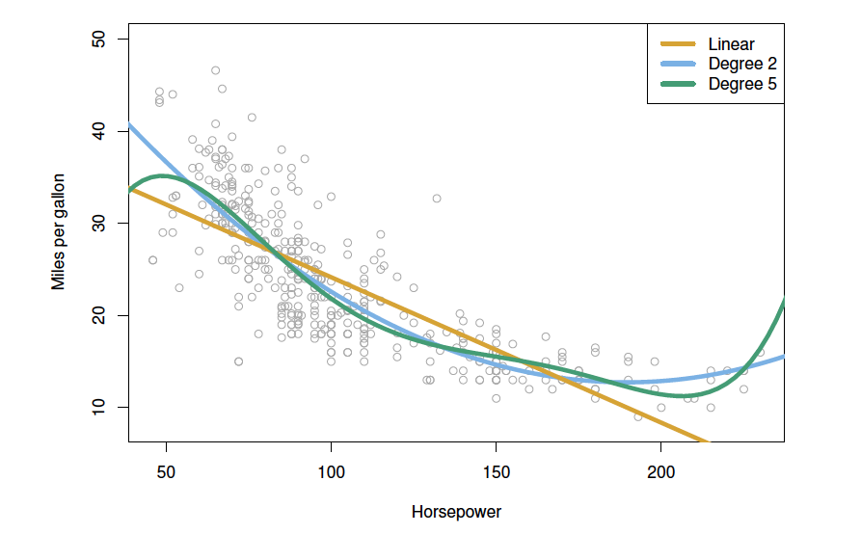
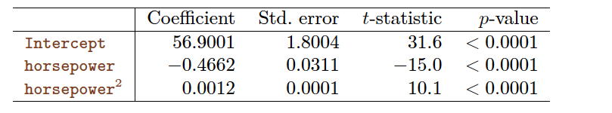
Non-Linear Relationships

Slide 39
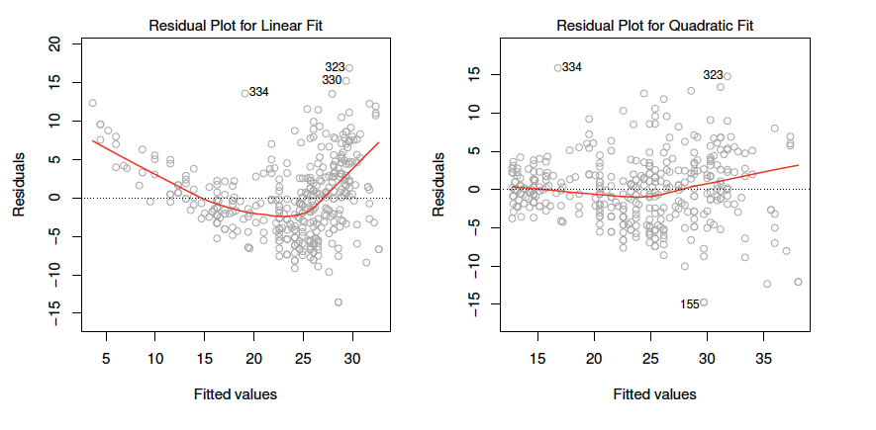
Potential Problems: Non-Linearity
Assumes a straight-line relationship between predictors and response.
Residual Plots
identify non-linearity
plot residuals vs. fitted values.
we don’t want to see any patterns!
What to do?
Non-linear transformation of variable.
log, square root, squared..

Slide 40
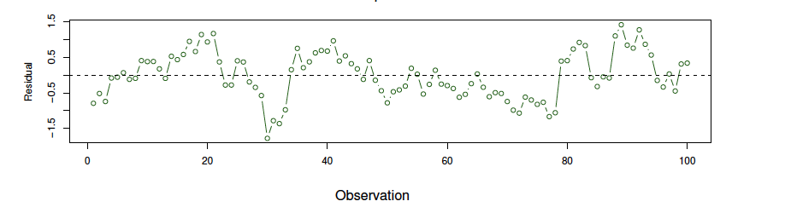
Potential Problems: Correlation of Error Terms
Why is it a problem?
Estimated Standard Errors underestimated.
Confidence intervals too small.
p-values too low.
…wrong conclusion that a variable is statistically significant!
What to do?
Usually means you aren’t accounting for something in your model!
Add a variable to try to capture that thing.

Slide 41
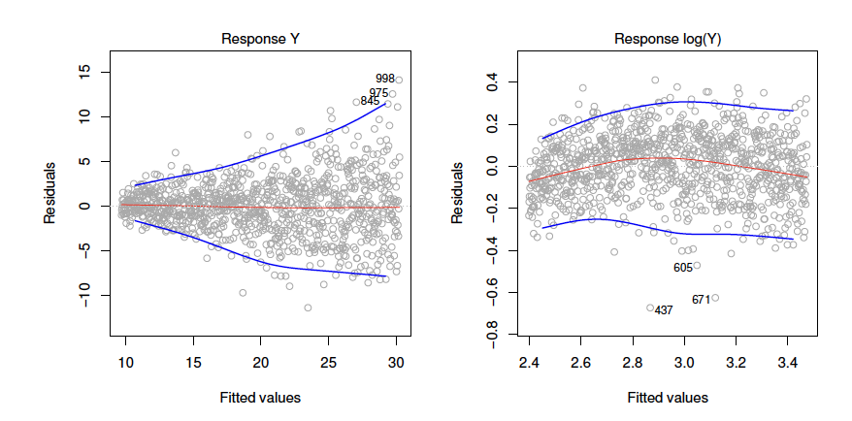
Potential Problems: Heteroskedasticity!
Error terms are assumed to have constant variance
What to do?
Try transforming Y (take the Log)
Use a modified regression (beyond the scope of today)

Slide 42
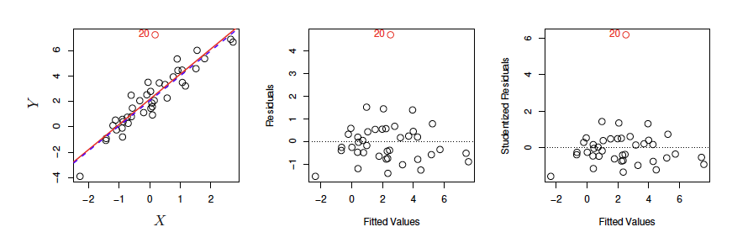
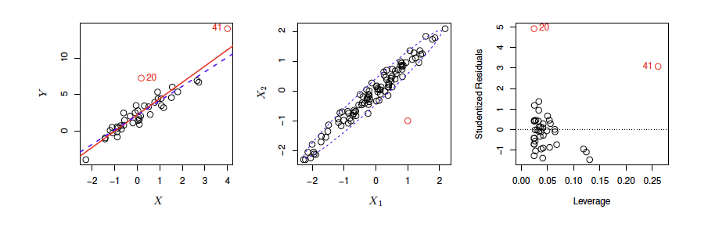
Potential Problems: Outliers
Only a problem when they are causing a problem!
They have high leverage.

Slide 43
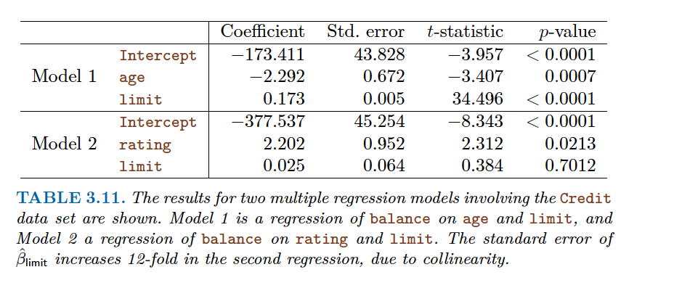
Potential Problems: Collinearity
Two or more predictors are closely related to each other.
Why is it a problem?
Reduces accuracy of estimates
causes standard errors of coefficients to grow.
t-values shrink
We may fail to reject a null hypothesis.
How to check?
VIF
Correlation Plots

Slide 44
https://quantdev.ssri.psu.edu/tutorials/cross-validation-tutorial

